Slide 1
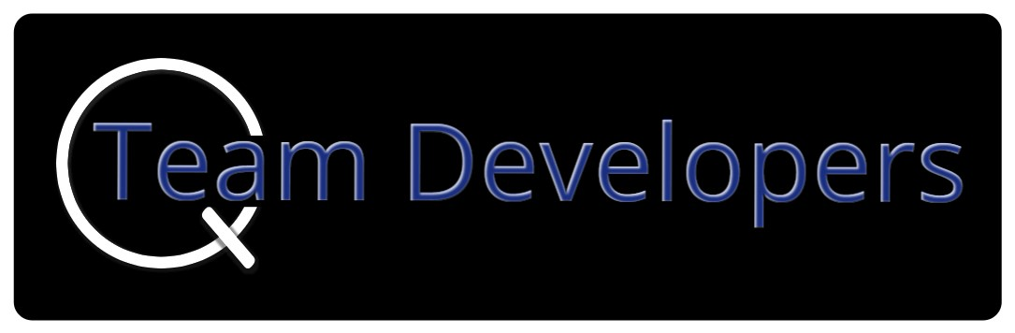
Post Mortem analysis of Spin Off by Q Team Developers
Dustin, Preston, Baoying, Isaac, & Karb

Slide 2
Outline:
Project break down
Coupling/Cohesion, did this work?
Next time, how we would break it down?
Other items in class that we would change to increase the learning experience
Outside features that could use pair programming

Slide 3
Isaac:
Collectables, objects, and graphics
Isaac is Team Lead 5

Slide 4
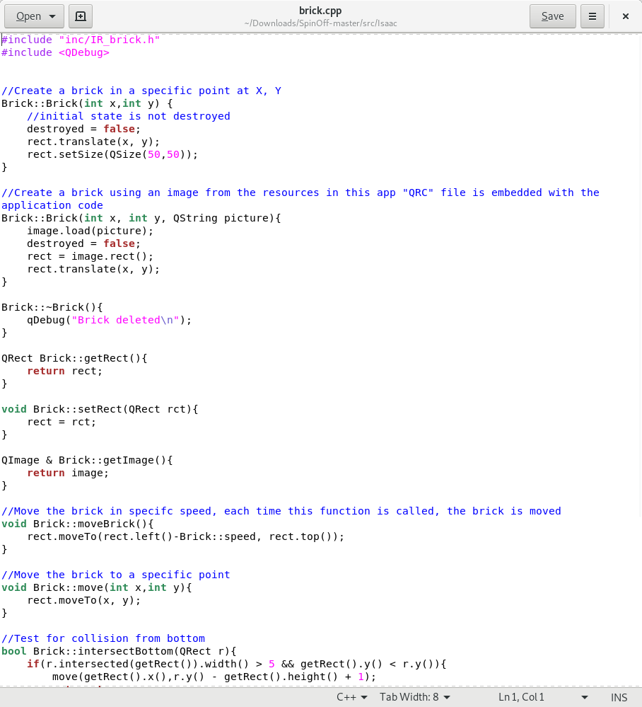
Isaac’s code:

Slide 5
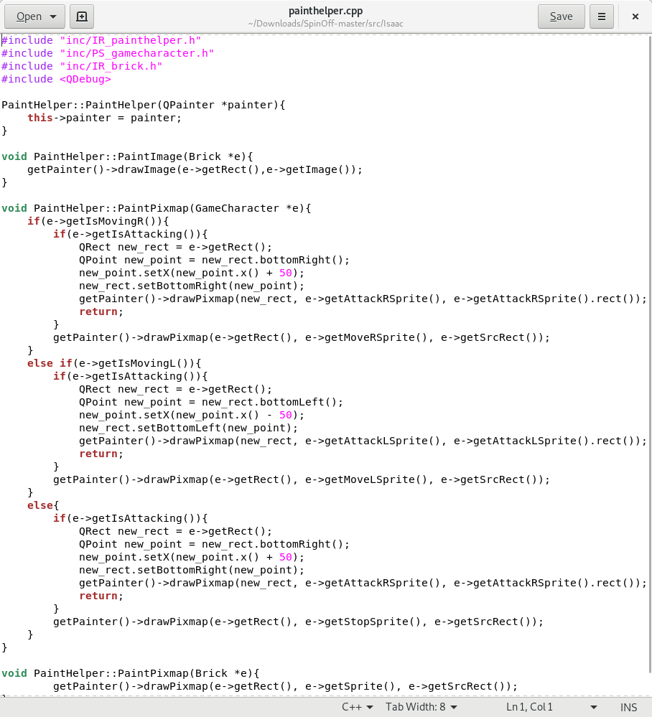
More of Isaac’s code:

Slide 6
Baoying
Player menu system, and dialog
Baoying is Team Lead 4

Slide 7
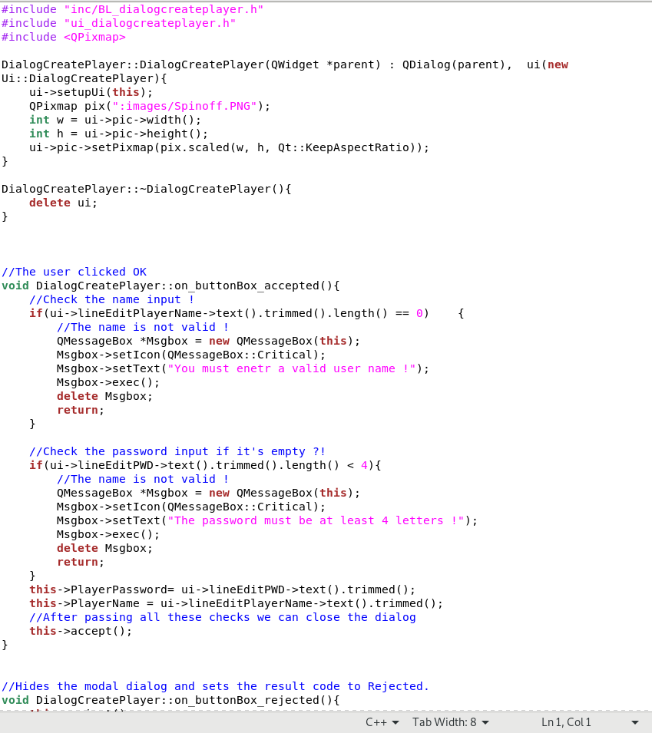
Baoying’s code

Slide 8
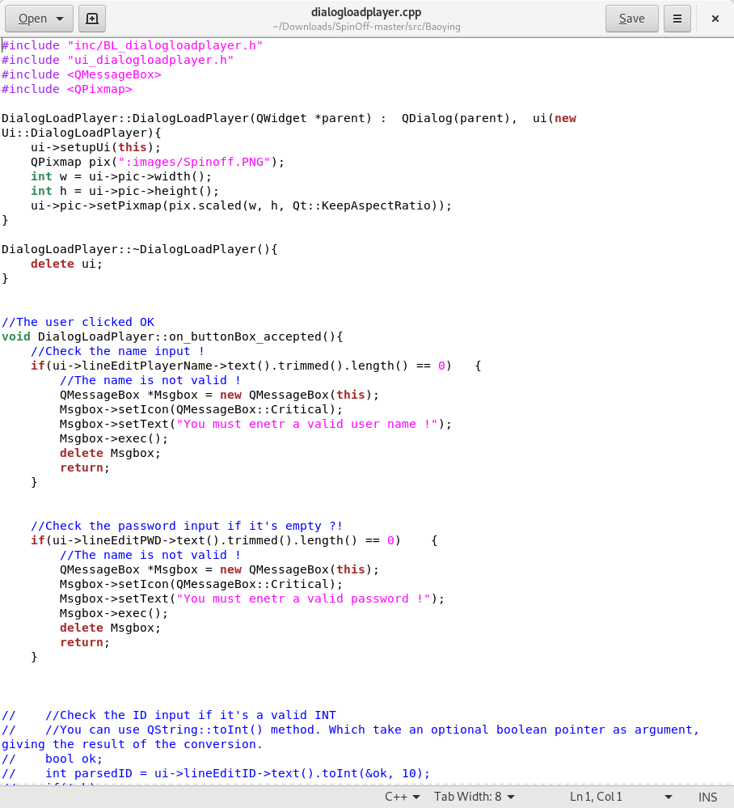
More of Baoying’s code

Slide 9
Dustin
Randomly level generation and testing
Dustin is Team Lead 3

Slide 10
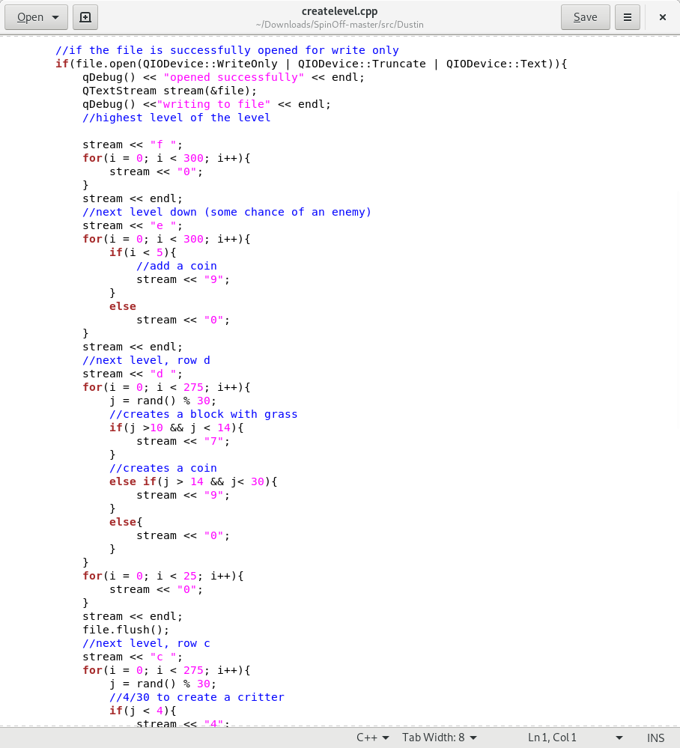
Dustin’s Code

Slide 11
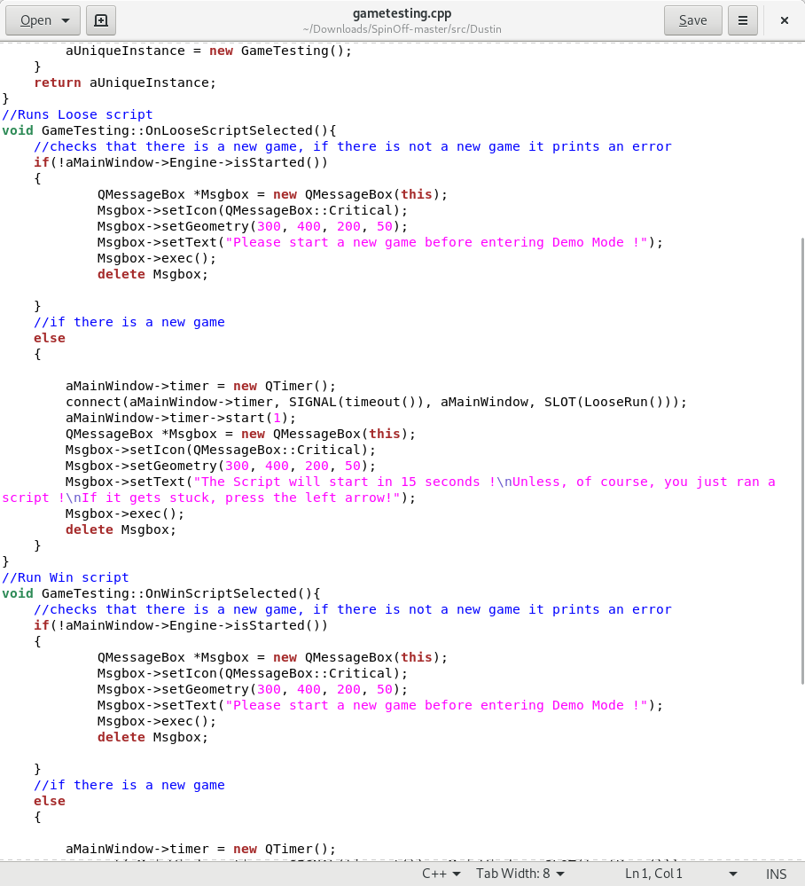
More of Dustin’s code

Slide 12
Karb
Initial game model, game engine, and demo
Karb is Team Lead 2

Slide 13
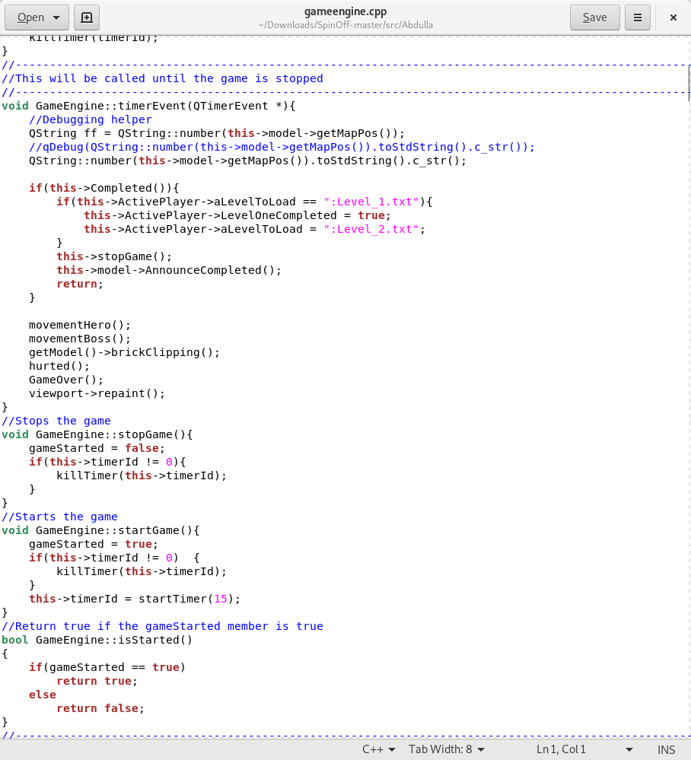
Karb’s code:

Slide 14
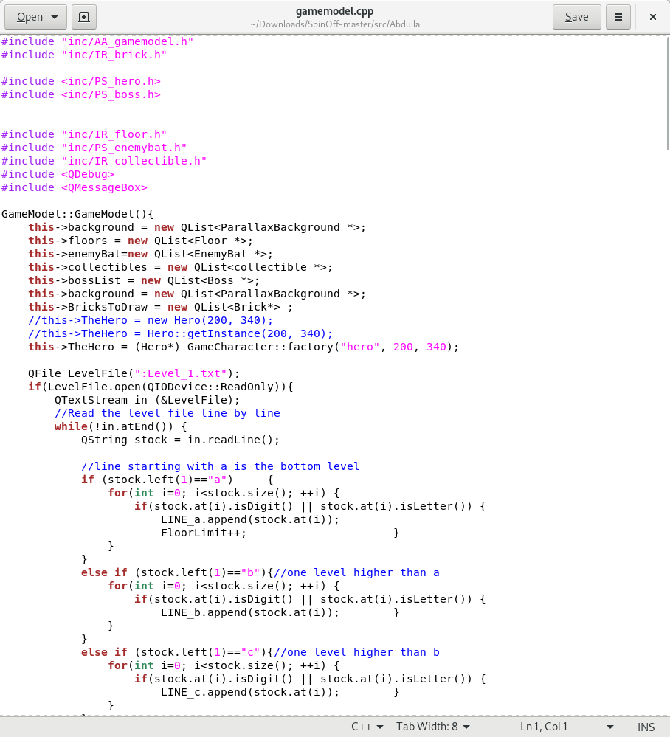
More of Karb’s code:

Slide 15
Preston
Enemies, GitHub, and collisions
Preston is Team Lead 5

Slide 16
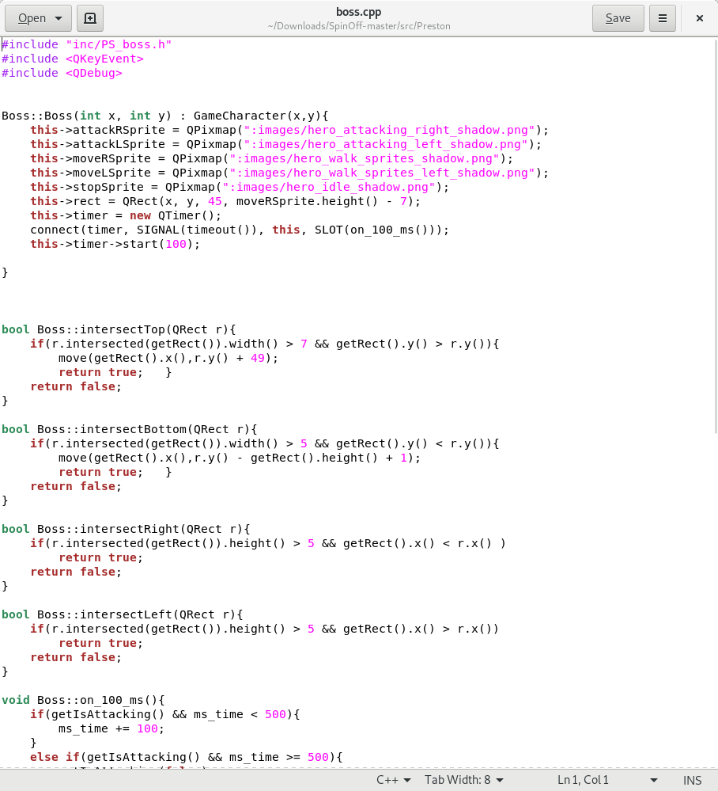
Preston’s code

Slide 17
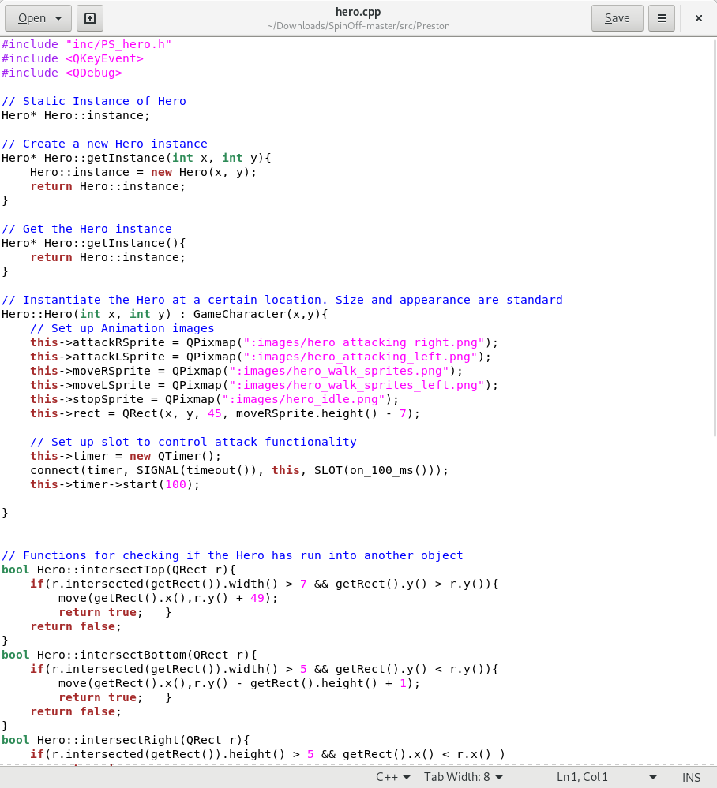
More of Preston’s code

Slide 18
Coupling/Cohesion
This worked because we each had tasks to complete that were able to be done without the others
At first this was a little scary, with no game there is no testing, object detection, etc
Eventually we had a running game and we were able to work on our tasks

Slide 19
What would we do differently?
Better communication at times
Mostly, this was a great project
Our running game is awesome!

Slide 20
Other items we would change about the class:
Once I figured it out where all the information about the class was and how it was organized, it was very helpful
We liked having the Team Leads where one person is in charge for a week or two
The option for which language and game engine to use was nice
We also like the optional final!

Slide 21
Outside features that could use Pair Programming

Slide 22
Thank you!!

